Slide 1
Booth’s Multiplication Algorithm
CSE-3109 Computer Architecture
Lecture 14

Slide 2
Booth’s Multiplication Algorithm
Booth's algorithm is a multiplication algorithm that multiplies two signed binary numbers in 2's compliment notation.
It employs both addition and subtraction.
It provides faster execution.

Slide 3
Booth’s Multiplication Algorithm
Step – 1:
Two adjacent bits x_{i}x_{i-1} are examined in each step.
If x_{i}x_{i-1} =01, then Y is added to the current partial product P_{i}.
If x_{i}x_{i-1} =10, then Y is subtracted from P_{i}.
If x_{i}x_{i-1} =00 or 11, then neither addition or subtraction is performed.
Step – 2:
Shift the product register right 1 bit.

Slide 4
Points to remember
When using Booth's Algorithm:
  You will need twice as many bits in your product as you have in your original two operands.
  The leftmost bit of your operands (both your multiplicand and multiplier) is a SIGN bit, and cannot be used as part of the value.

Slide 5
To Begin
First we have to decide which operand will be the multiplier and which will be the multiplicand.
Then we have to convert both operands to two's complement representation using X bits.
X must be at least one more bit than is required for the binary representation of the numerically larger operand.
Begin with a product that consists of the multiplier with an additional X leading zero bits.

Slide 6
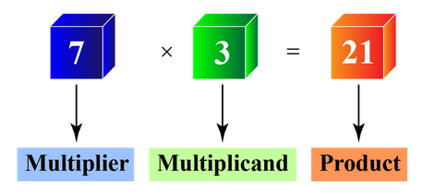
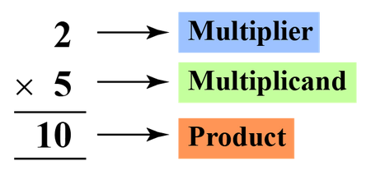
Multiplier and Multiplicand

Slide 7
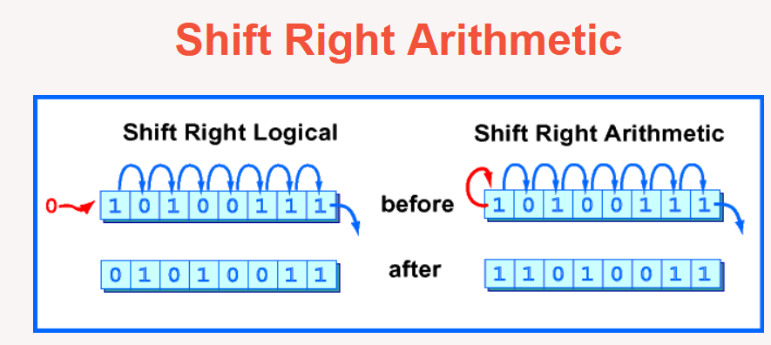
Arithmetic Right Shift

Slide 8
Example
For our example, let's multiply (-5) x 2
  The numerically larger operand (5) would require 3 bits to represent in binary (101). So we must use AT LEAST 4 bits to represent the operands, to allow for the sign bit.
Let's use 5-bit 2's complement:
  -5 is 11011 (multiplier)
  2 is 00010 (multiplicand)

Slide 9
Beginning Product
The multiplier is:
11011
Add 5 leading zeros to the multiplier to get the beginning product:
00000 11011

Slide 10
Step 1 for each pass
Use the LSB (least significant bit) and the previous LSB to determine the arithmetic action.
  If it is the FIRST pass, use 0 as the previous LSB.

Slide 11
Step 1 for each pass
Possible arithmetic actions:
  00 → no arithmetic operation
  01 → add multiplicand to left half of product
  10 → subtract multiplicand from left half of product
  11 → no arithmetic operation

Slide 12
Step 2 for each pass
NOTE: For X-bit operands, Booth's algorithm requires X passes.

Slide 13
Rules for substraction
0-0=0
1-0=1
1-1=0
0-1=1 (Carry 1)
0-10=0 (Carry 1)
1-10=1 (Carry 1)

Slide 14
Example
Let's continue with our example of multiplying (-5) × 2
Remember:
  -5 is 11011 (multiplier)
  2 is 00010 (multiplicand)
And we added 5 leading zeros to the multiplier to get the beginning product:
00000 11011

Slide 15
Example Continued
Initial Product and previous LSB
00000 11011 0
(Note: Since this is the first pass, we use 0 for the previous LSB)
Pass 1, Step 1: Examine the last 2 bits
00000 11011 0
The last two bits are 10, so we need to subtract the multiplicand from left half of product

Slide 16
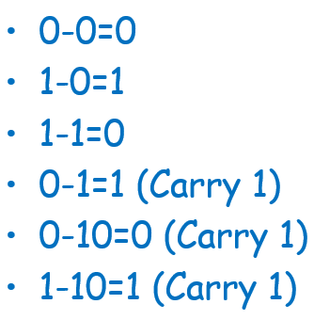
Pass 1, Step 1: Arithmetic action
(1) 00000 (left half of product)
-00010 (multiplicand)
11110
Place result into left half of product
11110 11011 0

Slide 17
Example Pass 1 Continued
Pass 1, Step 2: ASR (arithmetic shift right)
  Before ASR
  11110 11011 0
  After ASR
  11111 01101 1
  (left-most bit was 1, so a 1 was shifted in on the left)
Pass 1 is complete.

Slide 18
Pass 2, Step 1: Arithmetic action
Current Product and previous LSB
11111 01101 1
Pass 2, Step 1: Examine the last 2 bits
11111 01101 1
The last two bits are 11, so we do NOT need to perform an arithmetic action --
just proceed to step 2.

Slide 19
Example: Pass 2 continued
Pass 2, Step 2: ASR (arithmetic shift right)
  Before ASR
  11111 01101 1
  After ASR
  11111 10110 1
  (left-most bit was 1, so a 1 was shifted in on the left)
Pass 2 is complete.

Slide 20
Pass 3, Step 1: Arithmetic action
Example: Pass 3
Current Product and previous LSB
11111 10110 1
Pass 3, Step 1: Examine the last 2 bits
11111 10110 1
The last two bits are 01, so we need to:
add the multiplicand to the left half of the product

Slide 21
Example: Pass 3 continued
Pass 3, Step 1: Arithmetic action
(1) 11111 (left half of product)
+00010 (mulitplicand)
00001 (drop the leftmost carry)
Place result into left half of product
00001 10110 1

Slide 22
Example: Pass 3 continued
Pass 3, Step 2: ASR (arithmetic shift right)
  Before ASR
  00001 10110 1
  After ASR
  00000 11011 0
  (left-most bit was 0, so a 0 was shifted in on the left)
Pass 3 is complete.

Slide 23
Pass 4, Step 1: Arithmetic action
Current Product and previous LSB
00000 11011 0
Pass 4, Step 1: Examine the last 2 bits
00000 11011 0
The last two bits are 10, so we need to:
subtract the multiplicand from the left half of the product

Slide 24
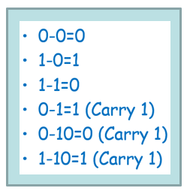
Example: Pass 4 Continued
Pass 4, Step 1: Arithmetic action
(1) 00000 (left half of product)
-00010 (multiplicand)
11110
Place result into left half of product
11110 11011 0
https://www.youtube.com/watch?v=hBLTmh8fDyw

Slide 25
Example: Pass 4 Continued
Pass 4, Step 2: ASR (arithmetic shift right)
  Before ASR
  11110 11011 0
  After ASR
  11111 01101 1
  (left-most bit was 1, so a 1 was shifted in on the left)
Pass 4 is complete.

Slide 26
Pass 5, Step 1: Arithmetic action
Current Product and previous LSB
11111 01101 1
Pass 5, Step 1: Examine the last 2 bits
11111 01101 1
The last two bits are 11, so we do NOT need to perform an arithmetic action --
just proceed to step 2.

Slide 27
Example: Pass 5 continued
Pass 5, Step 2: ASR (arithmetic shift right)
  Before ASR
  11111 01101 1
  After ASR
  11111 10110 1
  (left-most bit was 1, so a 1 was shifted in on the left)
Pass 5 is complete.

Slide 28
Final Product
We have completed 5 passes on the 5-bit operands, so we are done.
Dropping the previous LSB, the resulting final product is:
11111 10110

Slide 29
Verification
To confirm we have the correct answer, convert the 2's complement final product back to decimal.
Final product: 11111 10110
Decimal value: -10
which is the CORRECT product of:
  (-5) × 2
https://www.studytonight.com/computer-architecture/booth-multiplication-algorithm

Slide 30
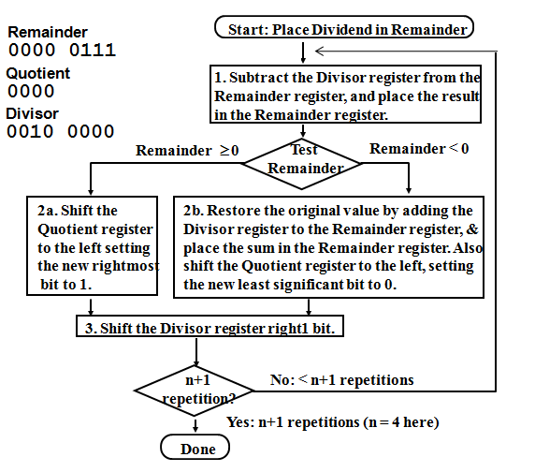
Restoring Division Algorithm

Slide 31
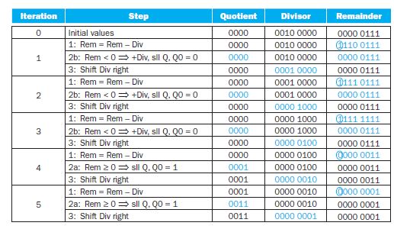
Division Example
Using a 4-bit version of the algorithm to save pages, let’s try dividing 7_{ten} by 2_{ten}, or 0000 0111_{two} by 0010_{two}.

Slide 32
End

